Slide 1
UNIT THREE Part Three

Slide 2
Traits of an ethical leader
The personality to defy groupthink
The ability to set a good example
Selflessness
They’re not afraid to be challenged
They take responsibility for everything

Slide 3
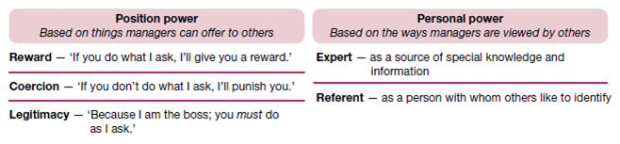
The nature of leadership
Leadership and vision
Power and influence

Slide 4
Sources of position power and personal power used by managers
Sources of position power
The three bases of position power are reward power, coercive power and legitimate power.
Reward power is the ability to influence through rewards. It is the capacity to offer something of value — a positive outcome — as a way of influencing the behaviour of other people.
Coercive power is the ability to influence through punishment. It is the capacity to punish or withhold positive outcomes as a way of influencing the behaviour of other people.
Expert power is the ability to influence through special expertise. It is the capacity to influence the behaviour of other people because they recognise your knowledge, understanding and skills
Referent power is the ability to influence through identification. It is the capacity to influence the behaviour of other people because they admire you and want to identify positively with you.

Slide 5
Turning power into influence
There is no substitute for expertise
(2) Likeable personal qualities are very important
(3) Effort and hard work breed respect
(4) Personal behaviour must support expressed values

Slide 6
Ethics and the limits to power
• The other person must truly understand the directive.
• The other person must feel capable of carrying out the directive.
• The other person must believe that the directive is in the organisation’s best interests.
• The other person must believe that the directive is consistent with personal values.

Slide 7
Empowerment
Effective leaders empower others by providing them with the information, responsibility, authority and trust to make decisions and act independently within their areas of expertise.

Slide 8
Leadership traits and behaviours
Drive
Self-confidence
Creativity.
Cognitive ability
Business knowledge.
Motivation
Flexibility.
Honesty and integrity.

Slide 9
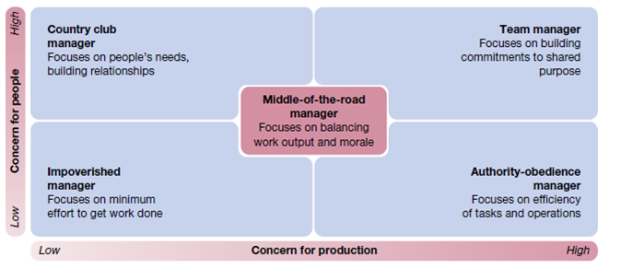

Slide 10
Transformational leadership
Transformational leadership describes someone who is truly inspirational as a leader and who arouses others to seek extraordinary performance accomplishments
Transactional leadership, which describes someone who is more methodical in keeping others focused on progress towards goal accomplishment. A transactional leader adjusts tasks, rewards and structures to move followers towards accomplishing organisational objectives
Vision
Charisma
Symbolism
Empowerment
Intellectual stimulation
Integrity

Slide 11
The critical components of emotional intelligence are the following.
i. Self-awareness is an ability to understand our own moods and emotions, and understand their impact on our work and on others.
ii. Self-regulation is the ability to think before we act and to control otherwise disruptive impulses.
iii. Motivation is the ability to work hard with persistence and for reasons other than money and status.
iv. Empathy is the ability to understand the emotions of others and to use this understanding to better relate to them.
v. Social skill is the ability to establish rapport with others and to build good relationships and networks.

Slide 12
Drucker’s ‘oldfashioned’ leadership
He identifies the following three essentials of leadership. First, defining and establishing a sense of mission. Second, accepting leadership as a responsibility rather than a rank. Third, earning and keeping the trust of others. ‘Effective leadership . . . is not based on being clever; it is based primarily on being consistent.

Slide 13
Moral leadership
This is leadership by ethical standards that clearly meet the test of being ‘good’ and ‘correct’.
Authentic leadership
An authentic leader has a high level of selfawareness and clearly understands his or her personal values.

Slide 14
Importance of Organizing
Efficient Administration
Resource Optimization
Benefits Specialization
Promotes Effective Communication
Creates Transparency
Expansion and Growth

Slide 15
Principles of Organizing
Work Specialization
Authority
Chain of Command
Delegation
Span of Control

Slide 16
The major advantages of functional structures include the following:
• Economies of scale with efficient use of resources
• Task assignments consistent with expertise and training
• High quality technical problem‐solving
• Indepth training and skill development within functions
• Clear career paths within functions.

Slide 17
The potential advantages of divisional structures include:
• More flexibility in responding to environmental changes
• Improved coordination across functional departments
• Clear points of responsibility for product or service delivery
• Expertise focused on specific customers, products and regions
Greater ease in changing size by adding or deleting divisions.

